Slide 1
Engaged Communities
February, 2020

Slide 2
Remember where we started: youth violence
Fall 2019
Bullying and fist fights
Bridge blockades
Stabbing outside building 85
Shooting at the INS Market across from MGCI
Responses slow and limited at best
→ we started Engaged Communities (Omar Khan, Ian Kaufman, Adil Patel, Safeera Mulla, Mussarat Ejaz, Abdul Rashid Athar)

Slide 3
Process: Community Engagement. Resident focused, resident led
Identifying and Prioritizing Problems Together
Planning Solutions Together
1
2
4
3
Evaluating Together
Implementing Solutions Together

Slide 4
Step 1: Identifying and Prioritizing Problems Together
Community engagement team meets many times with residents to:
identify problems connected with youth violence affecting families and youth
identify causes and root causes of these problems
select the problems community considers most important that need to be addressed

Slide 5
Engagement Meetings to Date
How many people interviewed? | Individual and family interviews with Thorncliffe Syrians: 5 families (5 moms, 5 dads), 8 youth (4 male, 4 female). 3 male youth were directly involved in fights, stabbing and shooting
How did we connect? | Omar’s existing connections + info from Hsain, CMHA youth worker
Time period | Started after shooting: November 2019 to January 2020
Length of interviews | 1 hour +
Interviewers | Omar, Ian, Heba (interpreter). Interpreter only with 2 families
Questions | Focus was youth violence, what they knew, their concerns, their perceptions, ideas for solutions, broader issues
Interview notes to results | Omar, in consultation with Ian. Verifying with Syrian families

Slide 6
What are we learning? Start with youth violence, all these intersecting areas come up

Slide 7
1. Education: “school irrelevant, struggling”
7. Racism:
“other youth groups, teachers, say racist things”
2. Lack of Voice: “Why aren’t police, teachers, principals listening to us?”
Social Determinants of Health
6. Housing: “rent too high, safety”
3. Economic Stability: “jobs, welfare”
5. Medical:
“youth mental health, parent health”
4. Neighbourhood: “where do youth go after school? Gang issues”

Slide 8
The social determinants of health connect all these areas. The engagement meetings identify and help prioritize areas of focus

Slide 9
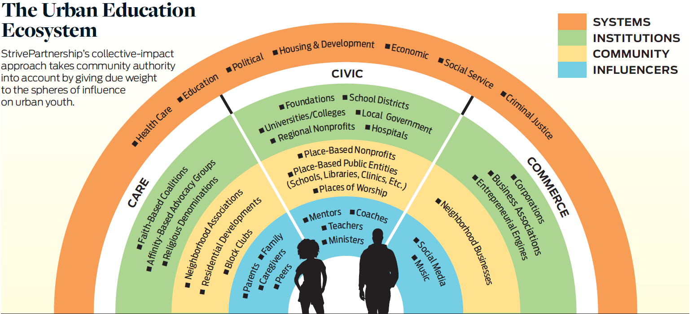
Who is going to work “the youth journey”? Many stakeholders
Source: White, Blatz & Joseph (2019)
Notes:
See https://knowledgeworks.org/resources/community-authority-collective-impact/ for more info on this graphic
Key idea is to consider the strengths in each of these areas, and build on those strengths, instead of just focusing on deficiencies.

Slide 10
Influencers: individuals with whom youth trusts and interacts with intimately
Source: White, Blatz & Joseph (2019)

Slide 11
Community: the organizations and informal associations aligned with place
Source: White, Blatz & Joseph (2019)

Slide 12
Institutions: the organizations and agencies that typically drive collective impact for urban youth
Youth success is a coordinated effort between family, community and many agencies. Question: in our community, who is or will be organizing for collective impact?
Source: White, Blatz & Joseph (2019)

Slide 13
Systems: large, mostly governmental agencies that drive policies
Source: White, Blatz & Joseph (2019)

Slide 14
Channels: Care, Civic and Commerce
Source: White, Blatz & Joseph (2019)

Slide 15
Commerce channel: engage youth primarily as a consumer
Source: White, Blatz & Joseph (2019)

Slide 16
Civic channel: focused on some aspect of youth development, such as health or education
Source: White, Blatz & Joseph (2019)

Slide 17
Care channel: committed to youth’s whole being
Youth must be involved in prioritizing problems and creating solutions because it’s their life. The care channel must also be involved because they are deeply committed to the youth.
Source: White, Blatz & Joseph (2019)

Slide 18
What is Engaged Communities trying to do?
Increase the capacity of residents to engage in community processes (e.g. parents councils, student councils, places of worship, building associations, neighbourhood groups, youth groups) so they are defining priorities and co-creating solutions with agencies
Help bring together the insights and resources of various groups and agencies who are already working on related issues but from different perspectives
Issues focused: for example, what started this, youth violence. But other issues, like housing affordability, healthcare, etc..

Slide 19
What is Engaged Communities doing now?
Engagement process Step 1: Verifying early findings with Syrian community, prioritizing issues
Running a larger community engagement
Engaging other stakeholders (Care channel: youth and parents from non-Syrian communities. Civic channel: schools, police, social agencies)
Describing what we are doing
Getting them on board
Getting funding to run community engagement training for residents
Working together on short-term interventions: e.g. Hsain/Aamir/Youth meetings, parents councils connections, connecting MGCI Principal Carlo with Syrian mother, various programs for youth

Slide 20
Solidifying pieces of step 1, preparing for step 2
Identifying and Prioritizing Problems Together
Planning Solutions Together
1
2
4
3
Evaluating Together
Implementing Solutions Together

